Slide 1
Chapter 5
Chapter 5
SNMPv1:
Communication and Functional Models
Network Management: Principles and Practice
© Mani Subramanian 2000
5-1

Slide 2
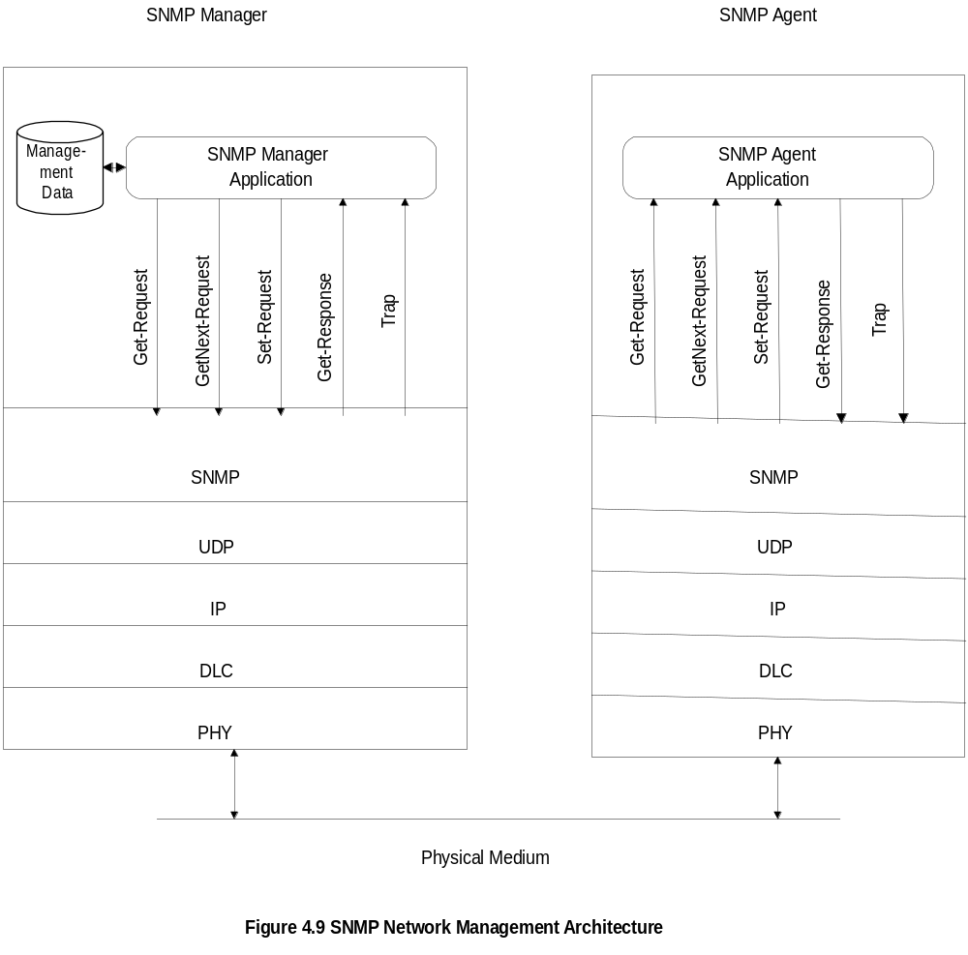
Chapter 5
SNMP Architecture
Notes
Truly simple network management protocol
Five messages, three from manager and two from agent
Network Management: Principles and Practice
© Mani Subramanian 2000
5-2

Slide 3
Chapter 5
SNMP Messages
Get-Request
Get-Next-Request
Set-Request
Get-Response
Trap
  Generic trap
  Specific trap
  Time stamp
Notes
Generic trap
  coldStart
  warmStart
  linkDown
  linkUp
  authenticationfailure
  egpNeighborLoss
  enterpriseSpecific
Specific trap
  for special measurements such as statistics
Time stamp: Time since last initialization
Network Management: Principles and Practice
© Mani Subramanian 2000
5-3

Slide 4
Chapter 5
Administrative Model
Based on community profile and policy
SNMP Entities:
  SNMP application entities
  - Reside in management stations and network
  elements
  - Manager and agent
  SNMP protocol entities
  - Communication processes (PDU handlers)
  - Peer processes that support application entities
Notes
Network Management: Principles and Practice
© Mani Subramanian 2000
5-4

Slide 5
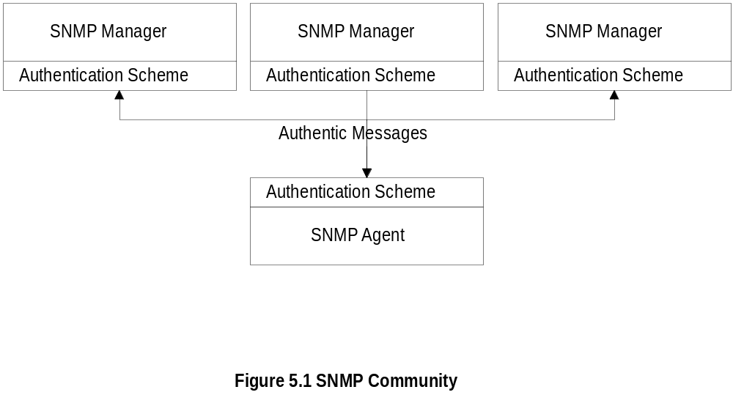
Chapter 5
SNMP Community
Notes
Security in SNMPv1 is community-based
Authentication scheme in manager and agent
Community: Pairing of two application entities
Community name: String of octets
Two applications in the same community
communicate with each other
Application could have multiple community names
Communication is not secured in SNMPv1 - no
encryption
Network Management: Principles and Practice
© Mani Subramanian 2000
5-5

Slide 6
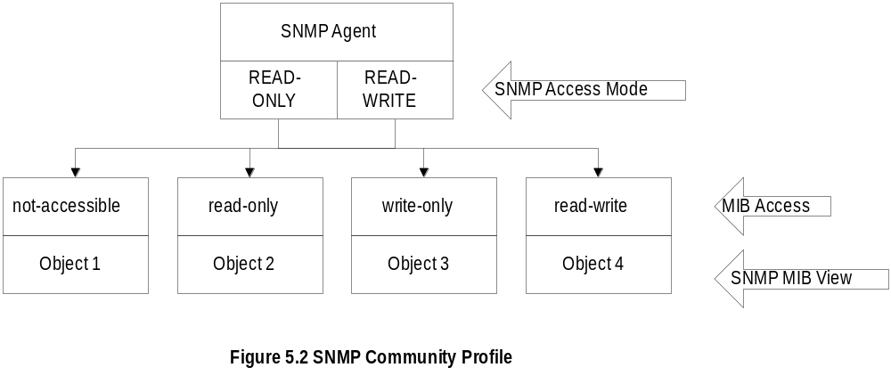
Chapter 5
Community Profile
Notes
MIB view
  An agent is programmed to view only a subset
  of managed objects of a network element
Access mode
  Each community name is assigned an access
  mode:: read-only and read-write
Community profile: MIB view + access mode
Operations on an object determined by community
profile and the access mode of the object
Total of four access privileges
Some objects, such as table and table entry are
non-accessible
Network Management: Principles and Practice
© Mani Subramanian 2000
5-6

Slide 7
Chapter 5
Administration Model
Administration model is SNMP access policy
SNMP community paired with SNMP
community profile is SNMP access policy
Notes
Parameters:
Community / communities
Agent / Agents
Manager / managers
Network Management: Principles and Practice
© Mani Subramanian 2000
5-7

Slide 8
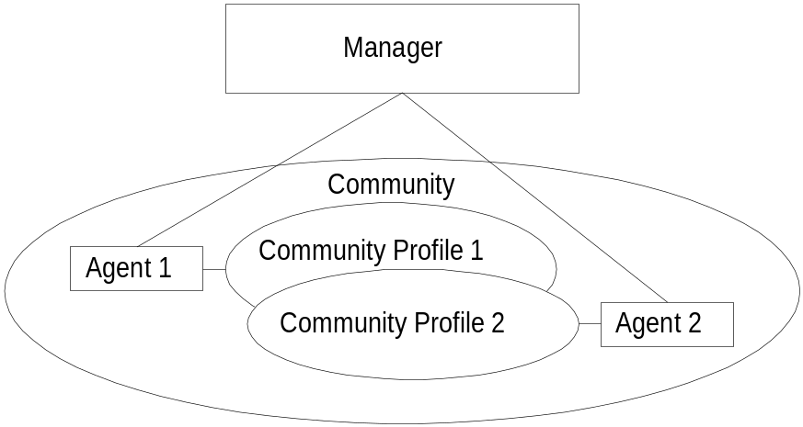
Chapter 5
Access Policy
Notes
Manager manages Community 1 and 2 network
components via Agents 1 and 2
Agent 1 has only view of Community Profile 1,
e.g. Cisco components
Agent 2 has only view of Community Profile 2,
e.g. 3Com components
Manager has total view of both Cisco and 3Com
components
Network Management: Principles and Practice
© Mani Subramanian 2000
5-8

Slide 9
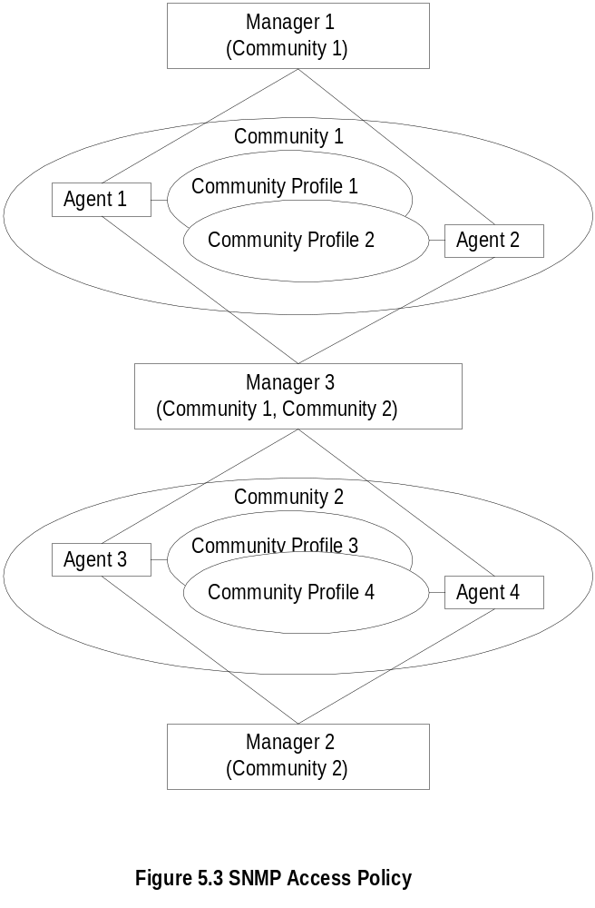
Chapter 5
Generalized Administration Model
Notes
Manager 1 manages community 1, manager 2
community 2,and manager 3 (MoM) both communities
1 and 2
Network Management: Principles and Practice
© Mani Subramanian 2000
5-9

Slide 10
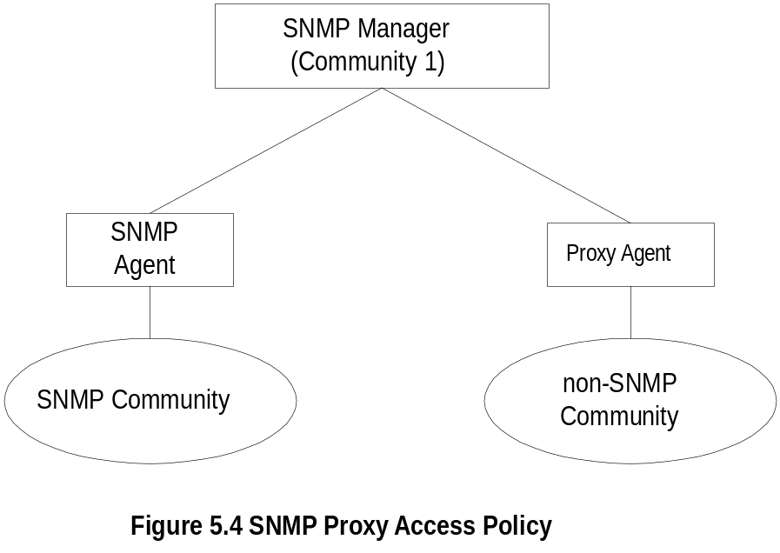
Chapter 5
Proxy Access Policy
Notes
Proxy agent enables non-SNMP community
elements to be managed by an SNMP manager.
An SNMP MIB is created to handle the non-SNMP
objects
Network Management: Principles and Practice
© Mani Subramanian 2000
5-10

Slide 11
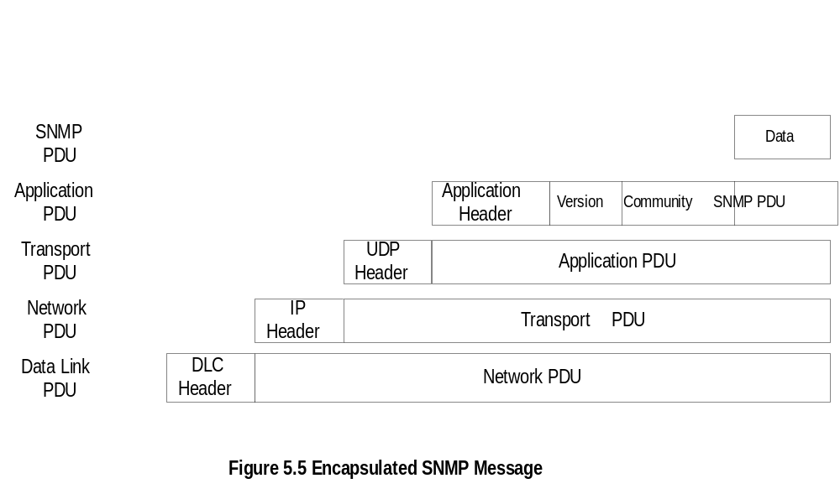
Chapter 5
Protocol Entities
Notes
Protocol entities support application entities
Communication between remote peer processes
Message consists of
  Version identifier
  Community name
  Protocol Data Unit
Message encapsulated and transmitted
Network Management: Principles and Practice
© Mani Subramanian 2000
5-11

Slide 12
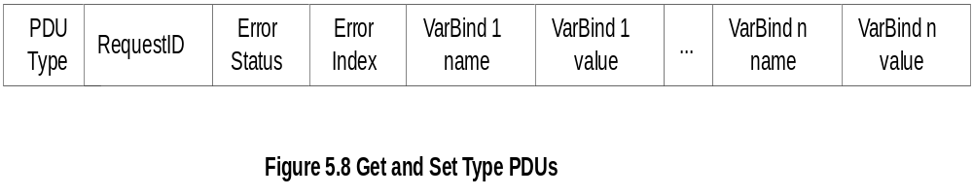
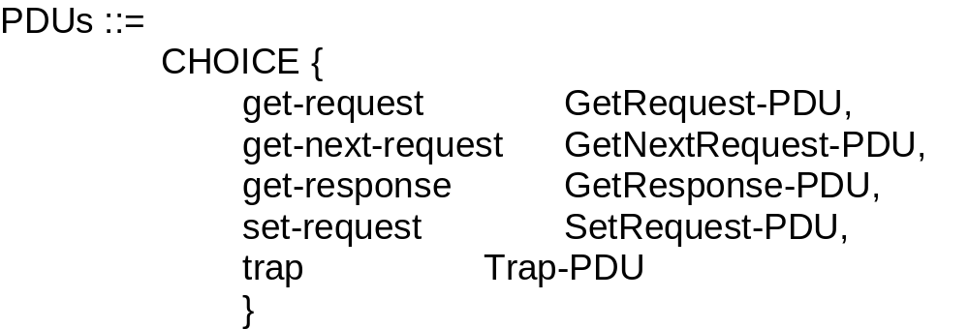
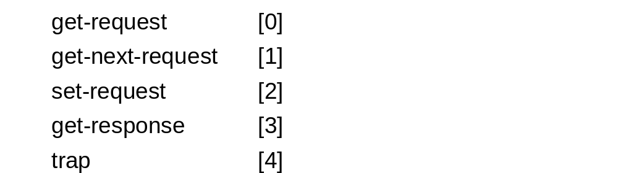
Chapter 5
Get and Set PDU
Notes
VarBindList: multiple instances of VarBind pairs
PDU Types: enumerated INTEGER
Network Management: Principles and Practice
© Mani Subramanian 2000
5-12

Slide 13
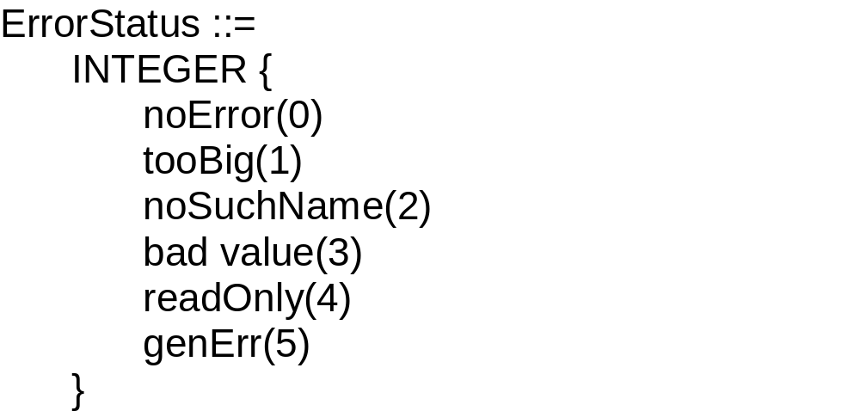
Chapter 5
Error in Response
Error Index: No. of VarBind that the first error occurred
Notes
Network Management: Principles and Practice
© Mani Subramanian 2000
5-13

Slide 14
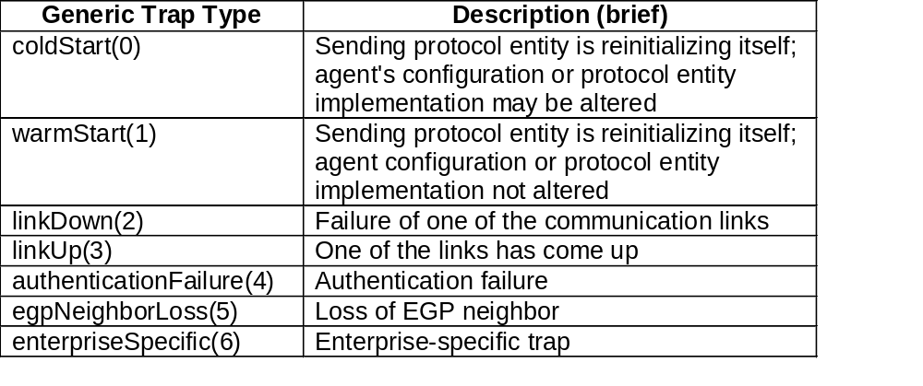
Chapter 5
Trap PDU
Notes
Enterprise and agent address pertain to the system
generating the trap
Seven generic traps specified by enumerated
INTEGER
Specific trap is a trap not covered by enterprise
specific trap
time stamp indicates elapsed time since last re-
initialization
Network Management: Principles and Practice
© Mani Subramanian 2000
5-14

Slide 15
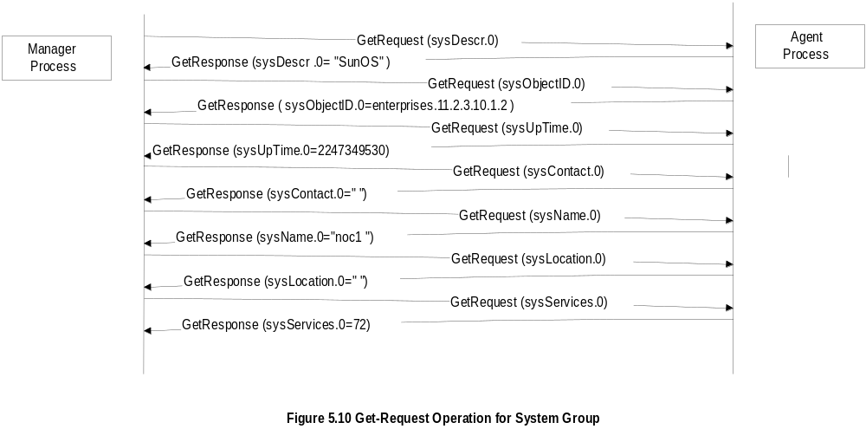
Chapter 5
SNMP Operations
Network Management: Principles and Practice
© Mani Subramanian 2000
5-15

Slide 16
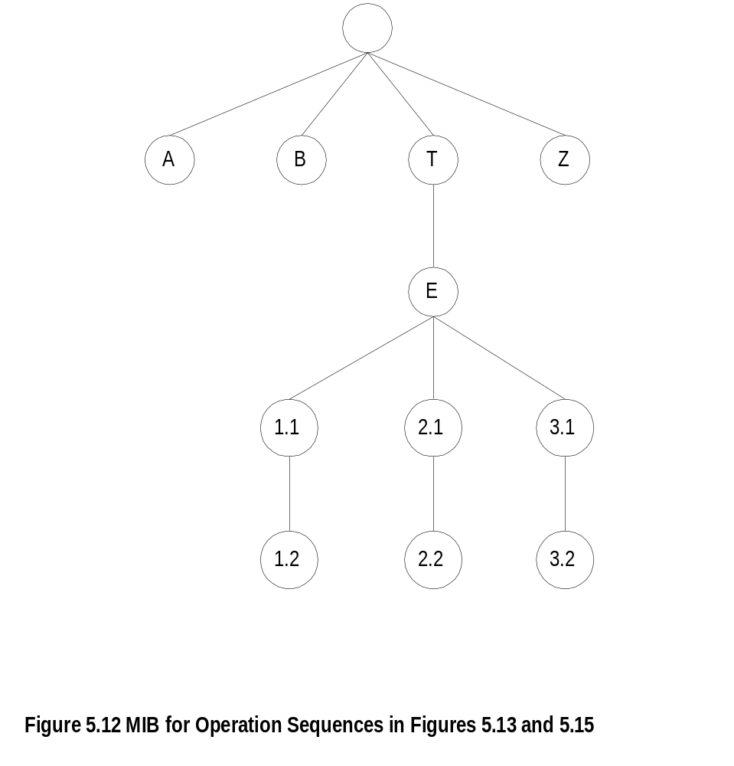
Chapter 5
MIB for Get-Next-Request
Notes
Network Management: Principles and Practice
© Mani Subramanian 2000
5-16

Slide 17
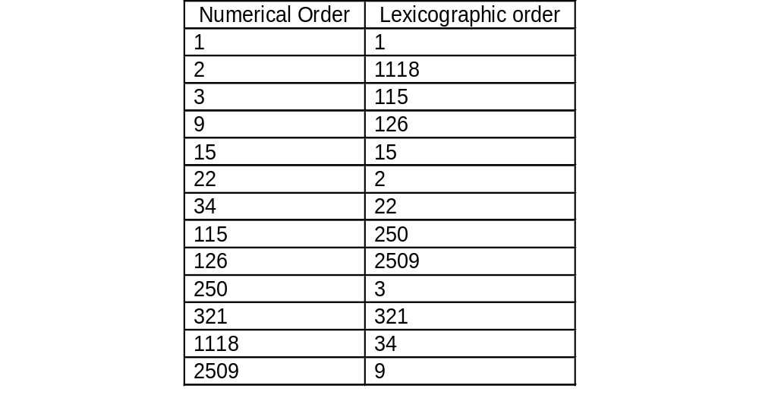
Chapter 5
Lexicographic Order
Notes
Procedure for ordering:
  Start with leftmost digit as first position
  Before increasing the order in the first position,
  select the lowest digit in the second position
  Continue the process till the lowest digit in
  the last position is captured
  Increase the order in the last position until all
  the digits in the last position are captured
  Move back to the last but one position and
  repeat the process
  Continue advancing to the first position until all
  the numbers are ordered
Tree structure for the above process
Network Management: Principles and Practice
© Mani Subramanian 2000
5-17

Slide 18
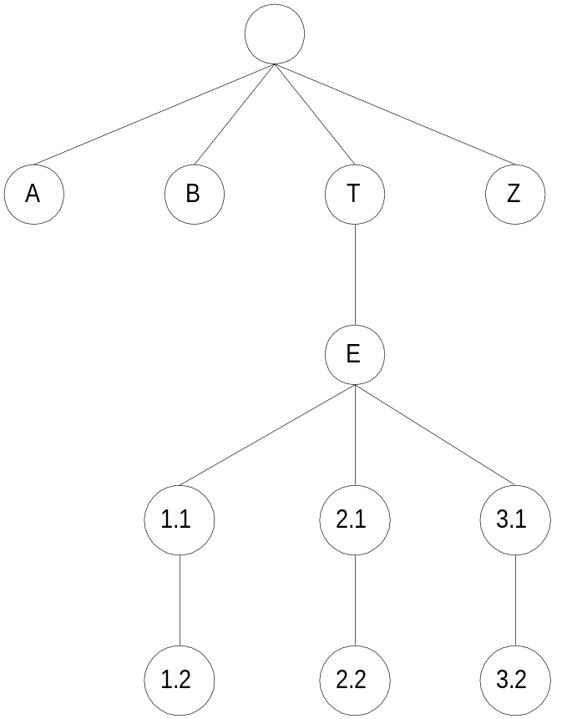
Chapter 5
MIB Lexicographic Order
Notes
A 3.1
B 3.2
T Z
E
1.1
1.2
2.1
2.2
Network Management: Principles and Practice
© Mani Subramanian 2000
5-18

Slide 19
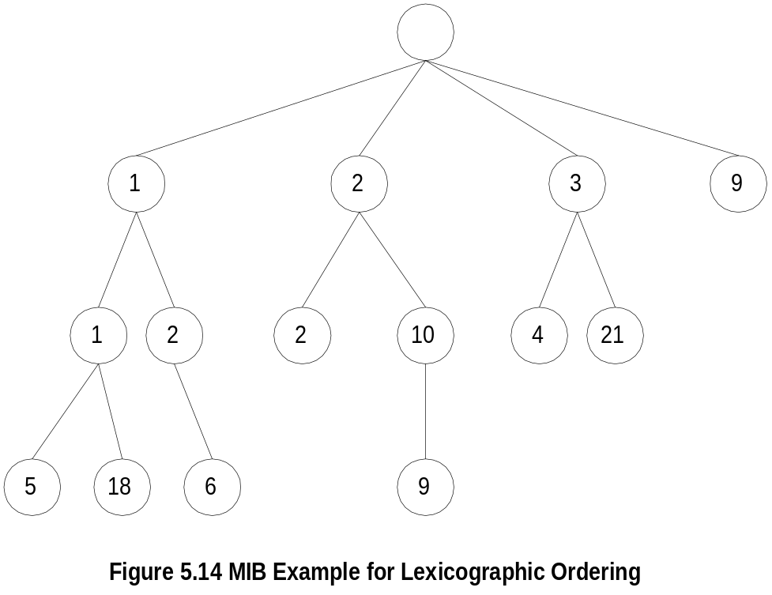
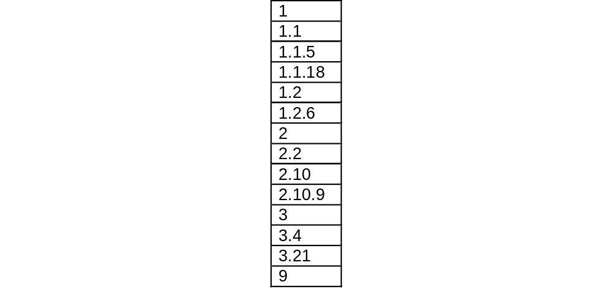
Chapter 5
A More Complex MIB Example
Notes
Network Management: Principles and Practice
© Mani Subramanian 2000
5-19

Slide 20
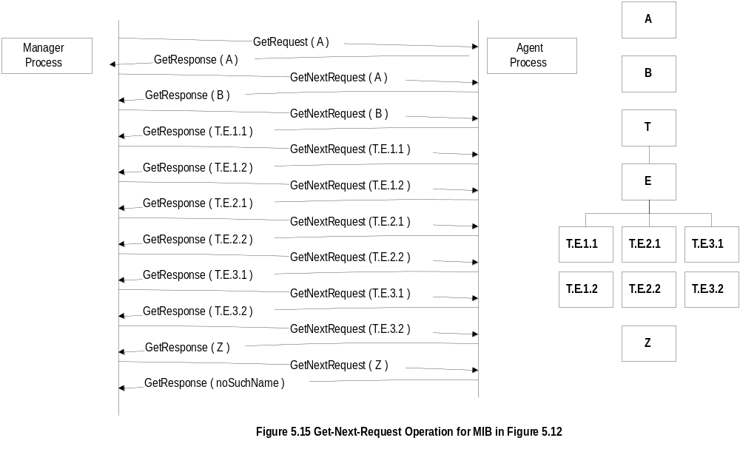
Chapter 5
Get-Next-Request Operation
Network Management: Principles and Practice
© Mani Subramanian 2000
5-20

Slide 21
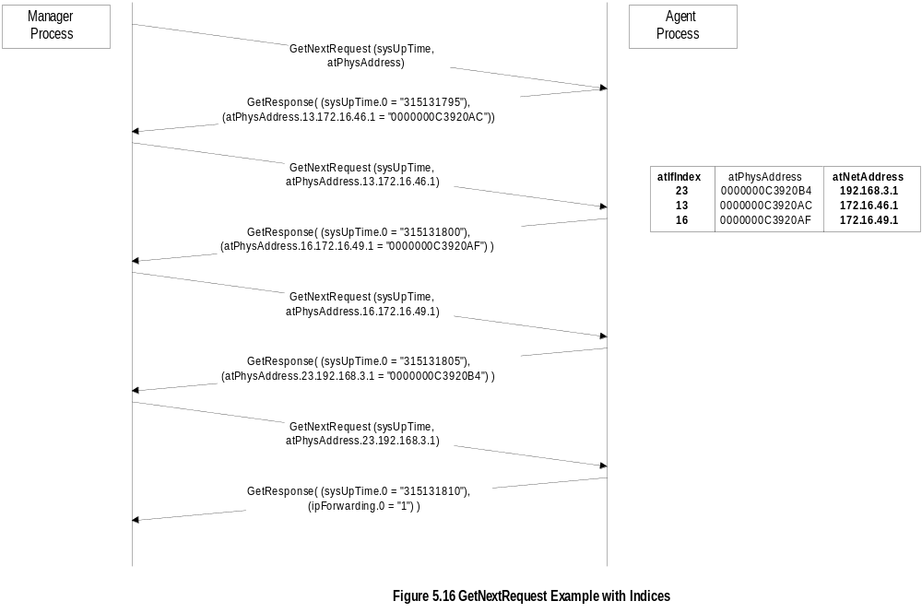
Chapter 5
Get-Next-Request Operation
Network Management: Principles and Practice
© Mani Subramanian 2000
5-21

Slide 22
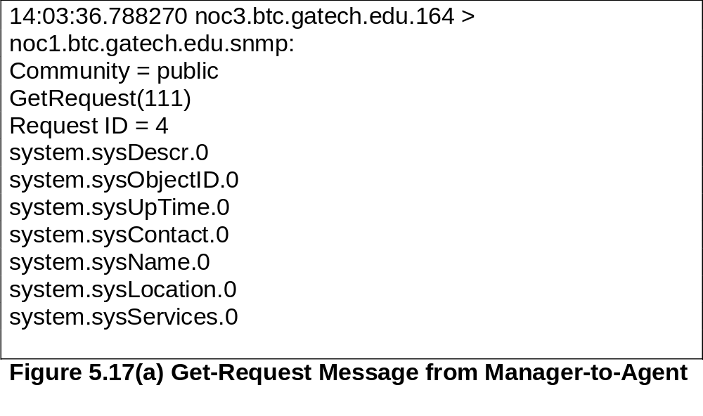
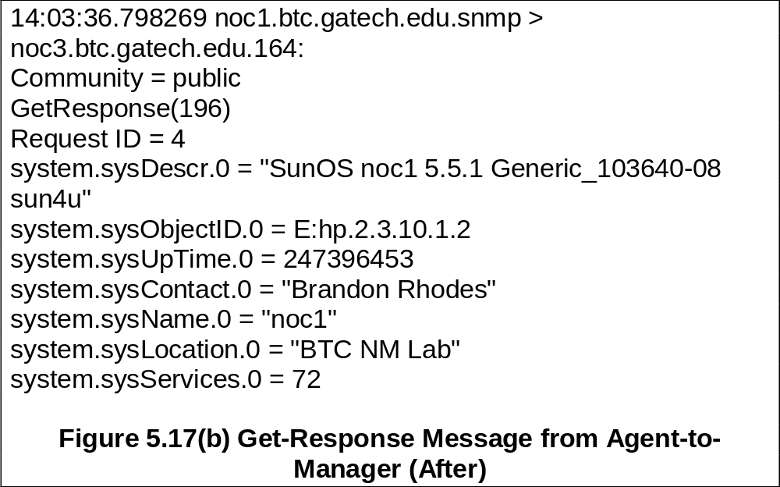
Chapter 5
Sniffer Data
Network Management: Principles and Practice
© Mani Subramanian 2000
5-22

Slide 23
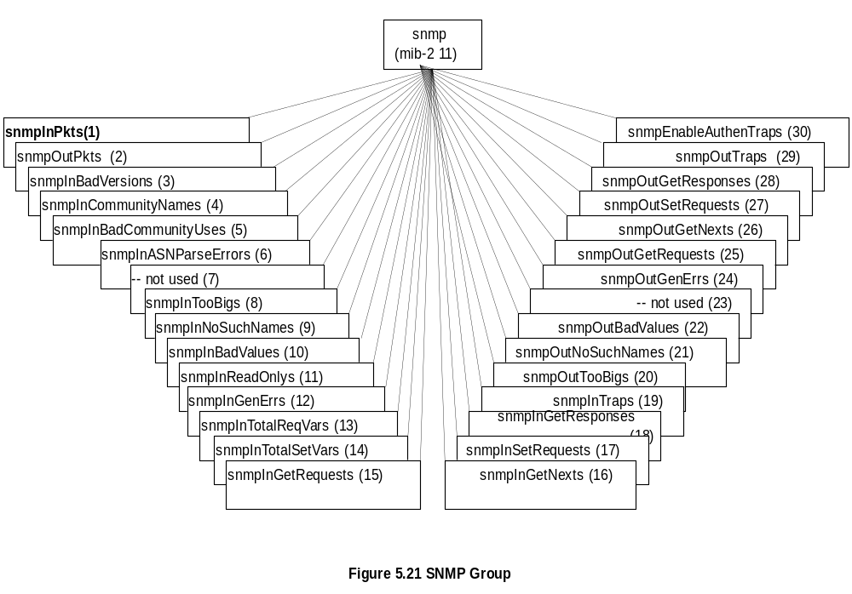
Chapter 5
SNMP MIB
Note: Most of the MIB objects were not used and hence deprecated in SNMPv2
Network Management: Principles and Practice
© Mani Subramanian 2000
5-23

